Slide 1

Trees
C H A P T E R 16
I like trees because they seem more resigned to the way they have to live than other things do.
—Willa Cather, O Pioneers!, 1913
16.1 Family trees
16.2 Binary search trees
16.3 Balanced trees
16.4 Implementing maps using BSTs
16.5 Partially ordered trees

Slide 2
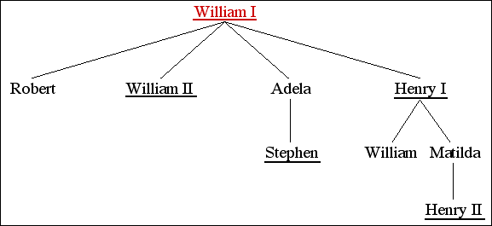
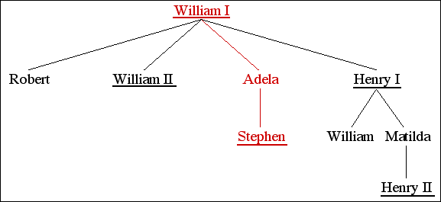
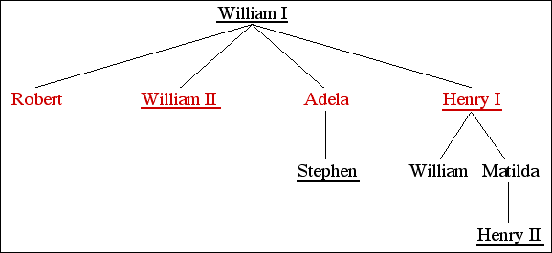
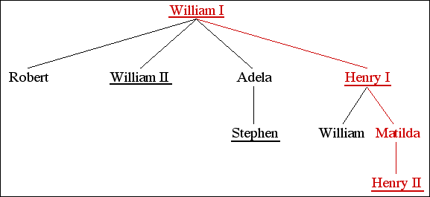
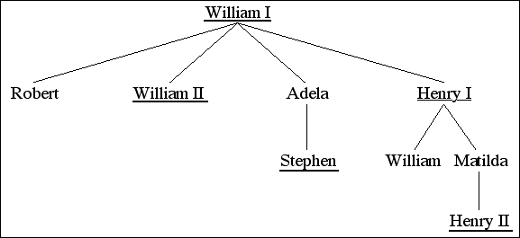
Trees
In the text, the first example I use to illustrate tree structures is the royal family tree of the House of Normandy:
This example is useful for defining terminology:
William I is the root of the tree.
Adela is a child of William I and the parent of Stephen.
Robert, William II, Adela, and Henry I are siblings.
Henry II is a descendant of William I, Henry I, and Matilda.
William I is an ancestor of everyone else in this tree.

Slide 3
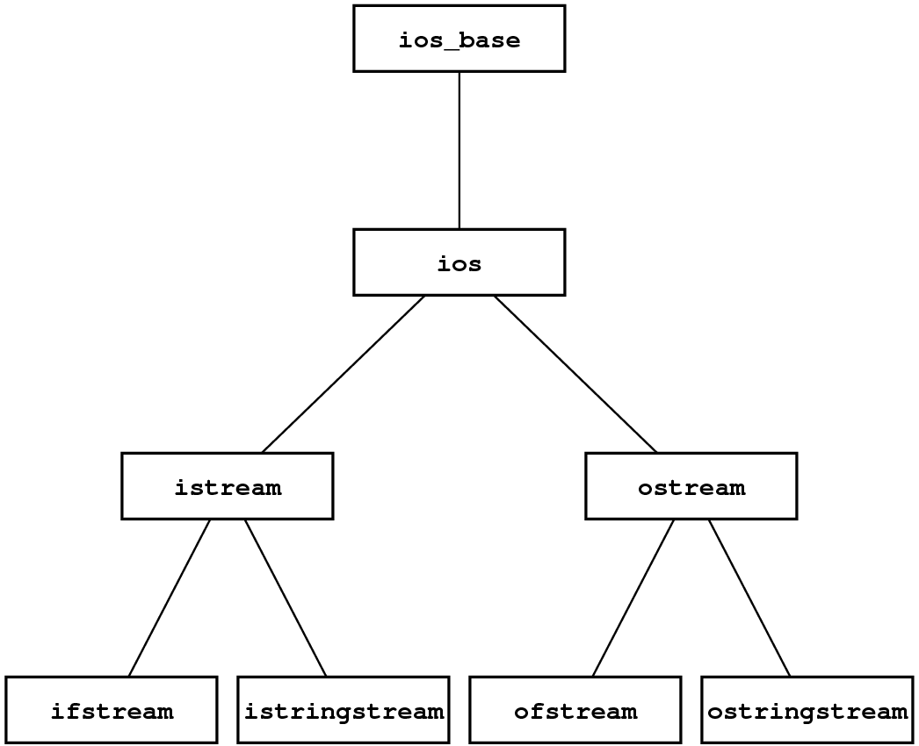
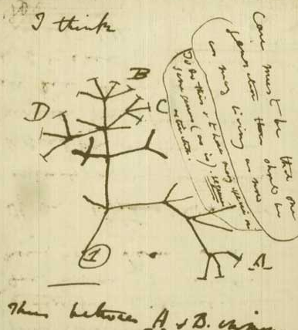
Trees Are Everywhere
Trees appear in many familiar contexts beyond family trees. The picture at the right comes from Darwin’s notebooks and shows his early conception of an evolutionary tree.
Trees also form the basis for the class hierarchies used in object-oriented programming languages like Java and C++.
In each of these contexts, trees begin with a single root node and then branch outward repeatedly to encompass any other nodes in the tree.

Slide 4
Trees as a Recursive Data Structure
If you think about trees as a programmer, the following definition is extremely useful:
A tree is a pointer to a node.
A node is a structure that contains some number of trees.
Although this definition is clearly circular, it is not necessarily infinite, either because
Tree pointers can be NULL indicating an empty tree.
Nodes can contain an empty list of children.
In C++, programmers typically define a structure or object type to represent a node and then use an explicit pointer type to represent the tree.

Slide 5
Binary Search Trees
The tree that supports the implementation of the Map class is called a binary search tree (or BST for short). Each node in a BST has exactly two subtrees: a left subtree that contains all the nodes that come before the current node and a right subtree that contains all the nodes that come after it. Either or both of these subtrees may be NULL.
The classic example of a binary search tree uses the names from Walt Disney’s Snow White and the Seven Dwarves:
Grumpy
Doc
Sleepy
Bashful
Dopey
Happy
Sneezy

Slide 6
A Simple BST Implementation
To get a sense of how binary search trees work, it is useful to start with a simple design in which keys are always strings.
Each node in the tree is then a structure containing a key and two subtrees, each of which is either NULL or a pointer to some other node. This design suggests the following definition:
struct Node {
string key;
Node *left, *right;
};
The code for finding a node in a tree begins by comparing the desired key with the key in the root node. If the strings match, you’ve found the correct node; if not, you simply call yourself recursively on the left or right subtree depending on whether the key you want comes before or after the current one.

Slide 7
Exercise: Building a Binary Search Tree
Diagram the BST that results from executing the following code:
colors
Node *colors = NULL;
insertNode(colors, "red");
insertNode(colors, "orange");
insertNode(colors, "yellow");
insertNode(colors, "green");
insertNode(colors, "blue");
insertNode(colors, "indigo");
insertNode(colors, "violet");
red
orange
yellow
green
violet
blue
indigo

Slide 8
A Simple BST Implementation
/*
* Type: Node
* ----------
* This type represents a node in the binary search tree.
*/
struct Node {
string key;
Node *left, *right;
};
/*
* Function: findNode
* Usage: Node *node = findNode(t, key);
* -------------------------------------
* Returns a pointer to the node in the binary search tree t than contains
* a matching key. If no such node exists, findNode returns NULL.
*/
Node *findNode(Node *t, string key) {
if (t == NULL) return NULL;
if (key == t->key) return t;
if (key < t->key) {
return findNode(t->left, key);
} else {
return findNode(t->right, key);
}
}

Slide 9
A Simple BST Implementation
/*
* Type: Node
* ----------
* This type represents a node in the binary search tree.
*/
struct Node {
string key;
Node *left, *right;
};
/*
* Function: findNode
* Usage: Node *node = findNode(t, key);
* -------------------------------------
* Returns a pointer to the node in the binary search tree t than contains
* a matching key. If no such node exists, findNode returns NULL.
*/
Node *findNode(Node *t, string key) {
if (t == NULL) return NULL;
if (key == t->key) return t;
if (key < t->key) {
return findNode(t->left, key);
} else {
return findNode(t->right, key);
}
}
/*
* Function: insertNode
* Usage: insertNode(t, key);
* --------------------------
* Inserts the specified key at the appropriate location in the
* binary search tree rooted at t. Note that t must be passed
* by reference, since it is possible to change the root.
*/
void insertNode(Node * & t, string key) {
if (t == NULL) {
t = new Node;
t->key = key;
t->left = t->right = NULL;
return;
}
if (key == t->key) return;
if (key < t->key) {
insertNode(t->left, key);
} else {
insertNode(t->right, key);
}
}

Slide 10
Traversal Strategies
It is easy to write a function that performs some operation for every key in a binary search tree, because recursion makes it simple to apply that operation to each of the subtrees.
The order in which keys are processed depends on when you process the current node with respect to the recursive calls:
If you process the current node before either recursive call, the result is a preorder traversal.
If you process the current node after the recursive call on the left subtree but before the recursive call on the right subtree, the result is an inorder traversal. In the case of the simple BST implementation that uses strings as keys, the keys will appear in lexicographic order.
If you process the current node after completing both recursive calls, the result is a postorder traversal. Postorder traversals are particularly useful if you are trying to free all the nodes in a tree.

Slide 11
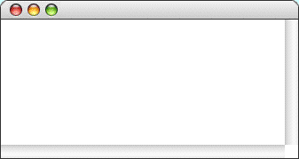
Exercise: Preorder Traversal
Grumpy
Doc
Sleepy
Bashful
Dopey
Happy
Sneezy
void preorderTraversal(Node *t) {
if (t != null) {
cout << t->key << endl;
preorderTraversal(t->left);
preorderTraversal(t->right);
}
}
PreorderTraversal
Grumpy
Doc
Bashful
Dopey
Sleepy
Happy
Sneezy

Slide 12
Exercise: Inorder Traversal
Grumpy
Doc
Sleepy
Bashful
Dopey
Happy
Sneezy
void inorderTraversal(Node *t) {
if (t != null) {
inorderTraversal(t->left);
cout << t->key << endl;
inorderTraversal(t->right);
}
}
InorderTraversal
Bashful
Doc
Dopey
Grumpy
Happy
Sleepy
Sneezy

Slide 13
Exercise: Postorder Traversal
Grumpy
Doc
Sleepy
Bashful
Dopey
Happy
Sneezy
void postorderTraversal(Node *t) {
if (t != null) {
postorderTraversal(t->left);
postorderTraversal(t->right);
cout << t->key << endl;
}
}
PostorderTraversal
Bashful
Dopey
Doc
Happy
Sneezy
Sleepy
Grumpy

Slide 14
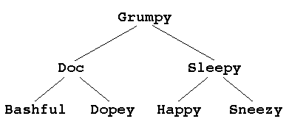
A Question of Balance
Ideally, a binary search tree containing the names of Disney’s seven dwarves would look like this:
If, however, you happened to enter the names in alphabetical order, this tree would end up being a simple linked list in which all the left subtrees were NULL and the right links formed a simple chain. Algorithms on that tree would run in O(N) time instead of O(log N) time.
A binary search tree is balanced if the height of its left and right subtrees differ by at most one and if both of those subtrees are themselves balanced.

Slide 15
Illustrating the AVL Algorithm
H
He
Li
Be
B
C

Slide 16
Illustrating the AVL Algorithm
H
H
=
He
Li
Be
B
C

Slide 17
Illustrating the AVL Algorithm
H
H
=
He
Li
Be
B
C

Slide 18
Illustrating the AVL Algorithm
H
H
+
He
Li
He
=
Be
B
C

Slide 19
Illustrating the AVL Algorithm
H
H
+
He
Li
He
=
Be
B
C

Slide 20
Illustrating the AVL Algorithm
H
H
++
He
Li
He
+
Be
B
Li
=
C

Slide 21
Illustrating the AVL Algorithm
H
=
H
++
He
Rotate left
Li
=
He
+
Be
B
Li
=
C

Slide 22
Illustrating the AVL Algorithm
H
=
He
He
Li
H
=
Li
=
Be
B
C

Slide 23
Illustrating the AVL Algorithm
H
–
He
He
Li
H
–
Li
=
Be
B
=
Be
C

Slide 24
Illustrating the AVL Algorithm
H
–
He
He
Li
H
–
Li
=
Be
B
=
Be
C

Slide 25
Illustrating the AVL Algorithm
H
–
He
He
Li
H
– –
Li
=
Be
B
–
Be
C
B
=

Slide 26
Illustrating the AVL Algorithm
H
–
He
He
Li
– –
=
=
H
=
Li
Be
Be
B
–
=
=
=
Rotate right
Be
H
B
C
B
=

Slide 27
Illustrating the AVL Algorithm
H
–
He
He
Li
Be
=
Li
=
Be
B
=
=
B
H
C

Slide 28
Illustrating the AVL Algorithm
H
– –
He
He
Li
Be
+
Li
=
Be
B
=
–
B
H
C
C
=

Slide 29

Illustrating the AVL Algorithm
H
++
He
– –
Rotate right
He
Li
–
Be
+
Li
=
Be
B
=
–
B
H
C
C
=

Slide 30
Illustrating the AVL Algorithm
H
– –
He
He
Li
Be
+
Li
=
Be
B
=
–
B
H
C
C
=

Slide 31
Illustrating the AVL Algorithm
H
– –
He
He
Li
– –
=
H
+
Li
Be
Be
B
Be
=
–
B
=
H
Rotate left
C
=
=
B
C
=
C

Slide 32
Illustrating the AVL Algorithm
H
– –
He
=
Rotate right
He
Li
+
–
H
– –
Li
=
Be
B
Be
=
C
B
=
C
=

Slide 33
Tree-Balancing Algorithms
The AVL algorithm was the first tree-balancing strategy and has been superseded by newer algorithms that are more effective in practice. These algorithms include:
–
Red-black trees
–
2-3 trees
–
AA trees
–
Fibonacci trees
–
Splay trees
At this point in your study of computer science, the important thing to know is that it is possible to keep a binary tree balanced as you insert nodes, thereby ensuring that lookup operations run in O(log N) time

Slide 34
Implementing Maps Using BSTs
The binary search tree structure makes it possible to define a Map class in which get and put operate in O(log N ) time while allowing iteration to proceed in order.
The following changes are required to implement the Map class:
The Node structure must be expanded to include a value field.
The class must include template parameters for both the key and value types.
The implementation must include the methods that define the complete Map interface, such as size, isEmpty, clear, and containsKey.
The implementation must overload operator[] to support the associative array syntax.

Slide 35
Partially Ordered Trees
If you implement them in the obvious way using either arrays or linked lists, priority queues require O(N) time. Because priority queues are essential to both Dijkstra’s and Kruskal’s algorithms, making them efficient improves performance.
The standard algorithm for implementing priority queues uses a data structure called a partially ordered tree, which makes it possible to implement priority queue operations in O(log N) time.
A partially ordered tree is a binary tree with these properties:
The tree is complete, which means that it is not only completely balanced but that each level of the tree is filled as far to the left as possible.
The root node of the tree has higher priority than the root of either of its subtrees.
Every subtree is also a partially ordered tree.

Slide 36
Exercise: Partially Ordered Trees
Insert in order:
17
93
20
42
68
11
17

Slide 37
Exercise: Partially Ordered Trees
Insert in order:
17
93
20
42
68
11
17
93

Slide 38
Exercise: Partially Ordered Trees
Insert in order:
17
93
20
42
68
11
17
93
20

Slide 39
Exercise: Partially Ordered Trees
Insert in order:
17
93
20
42
68
11
17
93
20
42

Slide 40
Exercise: Partially Ordered Trees
Insert in order:
17
93
20
42
68
11
17
93
20
42

Slide 41
Exercise: Partially Ordered Trees
Insert in order:
17
93
20
42
68
11
17
42
20
93
68

Slide 42
Exercise: Partially Ordered Trees
Insert in order:
17
93
20
42
68
11
17
42
20
93
68
11

Slide 43
Exercise: Partially Ordered Trees
Insert in order:
17
93
20
42
68
11
17
42
20
93
68
11

Slide 44
Exercise: Partially Ordered Trees
Insert in order:
17
93
20
42
68
11
17
42
11
93
68
20

Slide 45
Exercise: Partially Ordered Trees
Insert in order:
17
93
20
42
68
11
Dequeue the top priority element
11
42
17
93
68
20

Slide 46
Exercise: Partially Ordered Trees
Insert in order:
17
93
20
42
68
11
Dequeue the top priority element
11
20
42
17
93
68

Slide 47
The End

